Slide 1
The CAFF Camp Program: A Resilience-based Group Intervention for Children of Parents with Mental Illness
Tianhang Zhou, M.D., MMSc
Peking University Institute of Mental Health, Peking University Six Hospital

Slide 2
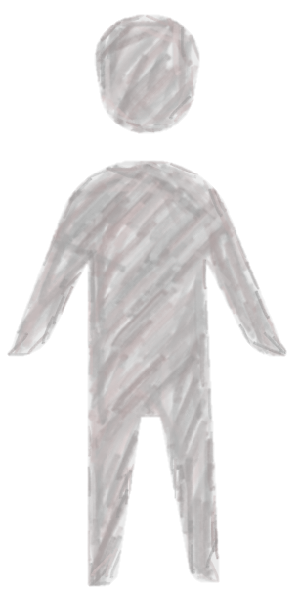
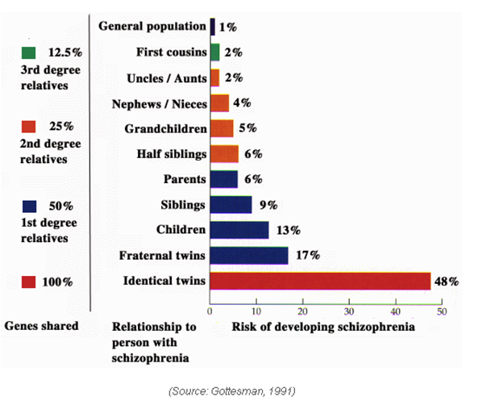
Children of Parents with Mental Illness
(COPMI)
患病风险
患精神疾病风险是同龄人2-3倍
心理特征
焦虑抑郁情绪
自我效能感低
社会行为
攻击行为多
学历差
就业率低
Genetic susceptibility

Slide 3
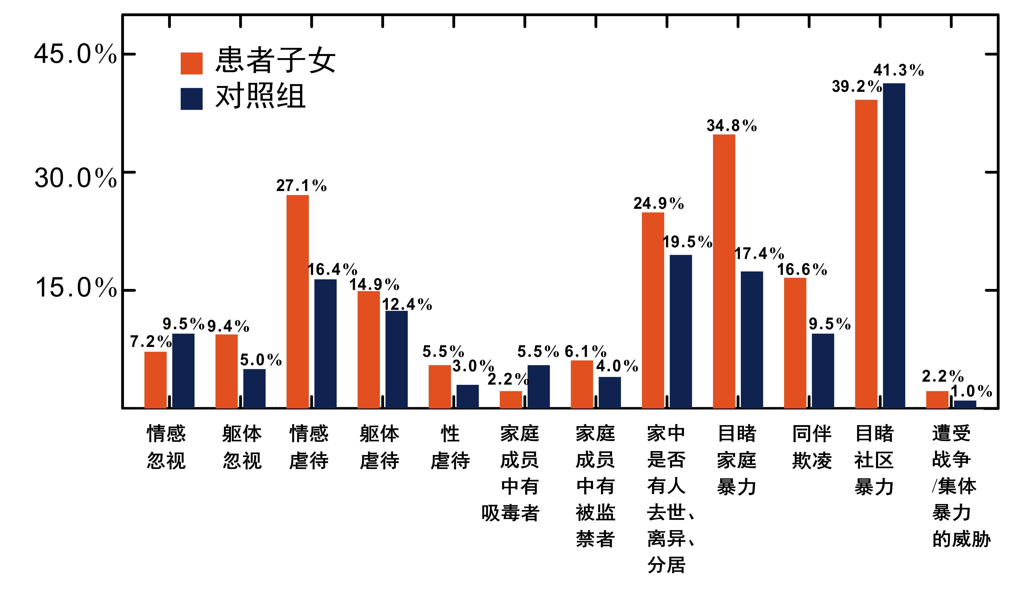
Children of Parents with Mental Illness
(COPMI)
Adverse childhood experiences
Genetic susceptibility
COPMI
Control
Emotional neglect
Emotional abuse
Sexual
abuse
Prisoners in family
Peer bullying
Physical neglect
Physical abuse
Drug abusers in family
Witness domestic violence
Witness violence

Slide 4
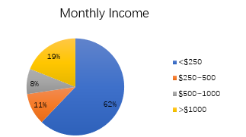
Children of Parents with Mental Illness
(COPMI)
Social isolation/Stigma
Adverse childhood experiences
Genetic susceptibility
Lower socio-economic status

Slide 5
Preventive/Early Intervention Programs
For parents/families | Let's Talk about Children Family Talk intervention Family Group CBT Prevention Program Effective Family Program Family Options Program Preventive Basic Care Management
For children | Parent-Baby Intervention Play & Support group program
For adolescents | CBT Prevention of Depression Program COPMI online programs Online Survival Education Program Peer support COPMI camps
Notes:
发达国家已经逐渐开始使用针对COPMI的内在需求并改善其社会心理结局的干预方案。适当的预防性干预措施已经在英国，美国，澳大利亚等国家得到应用，并已经被证实对于改善COPMI的社会心理结局有确定的效果。
早期干预的尝试包括但不限于：对COPMI进行心理支持、认知行为疗法、人际关系治疗、精神疾病相关知识讲解等。

Slide 6
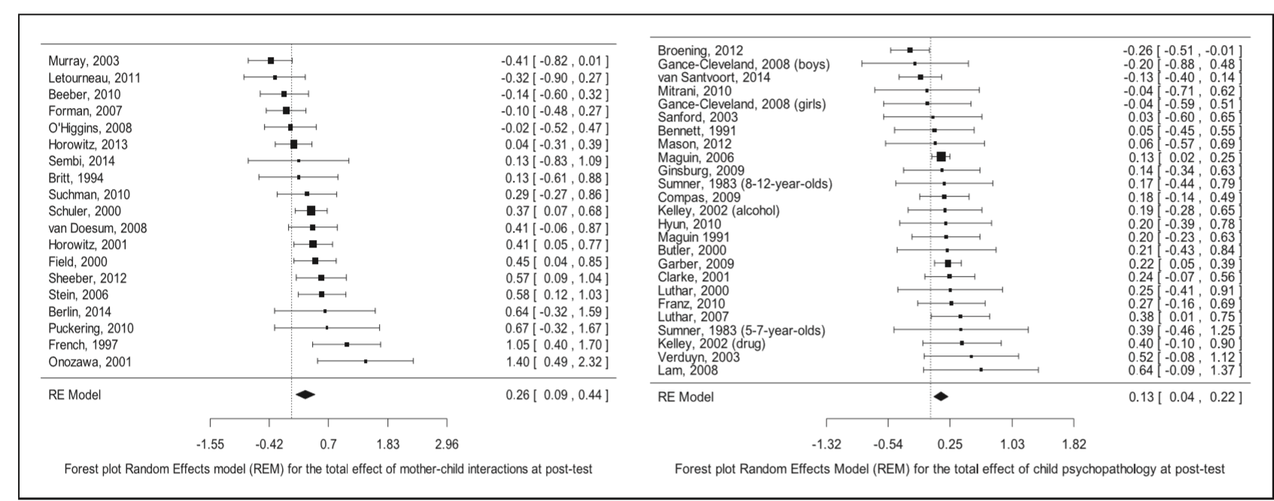
Effectiveness
Preventive intervention can significantly improve the parent-child relationship the psychopathological symptoms of COPMI.
Thanhäuser M, Lemmer G, De G G, et al. Do preventive interventions for children of mentally ill parents work? Results of a systematic review and meta-analysis. Current Opinion in Psychiatry, 2017, 30(4).
Notes:
（上图每行表示一个RCT研究，横线若与中间的虚线相交表示无统计学显著差异，最后一行的菱形表示将所有研究合并后发现，干预后有0.26/0.13的提升，且这个提升是有统计学差异的）

Slide 7
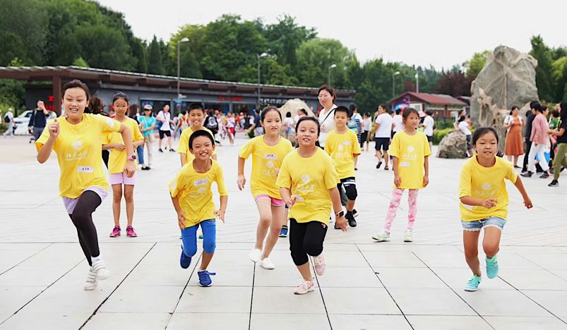
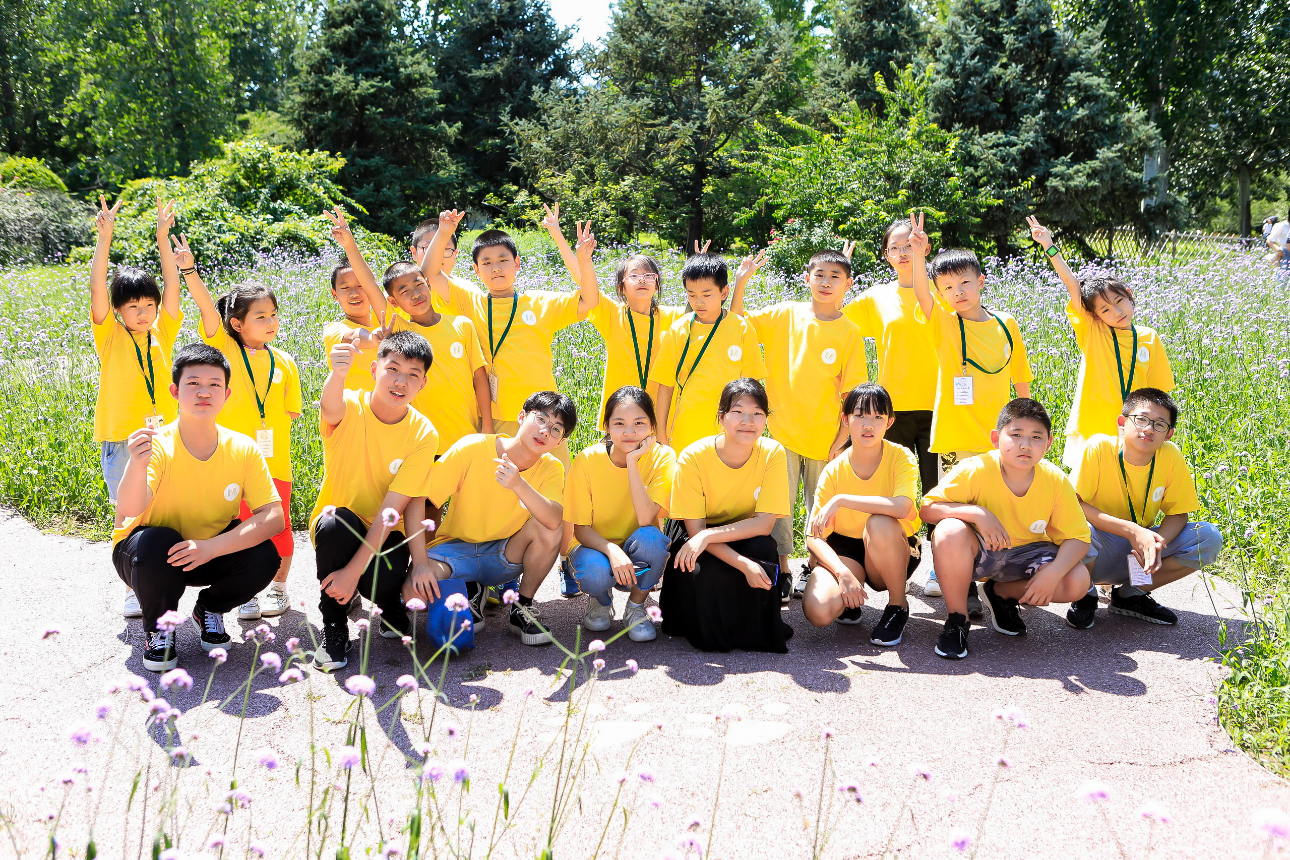
Run for Wellness, Live for Flourish
CAFF Summer Camps

Slide 8
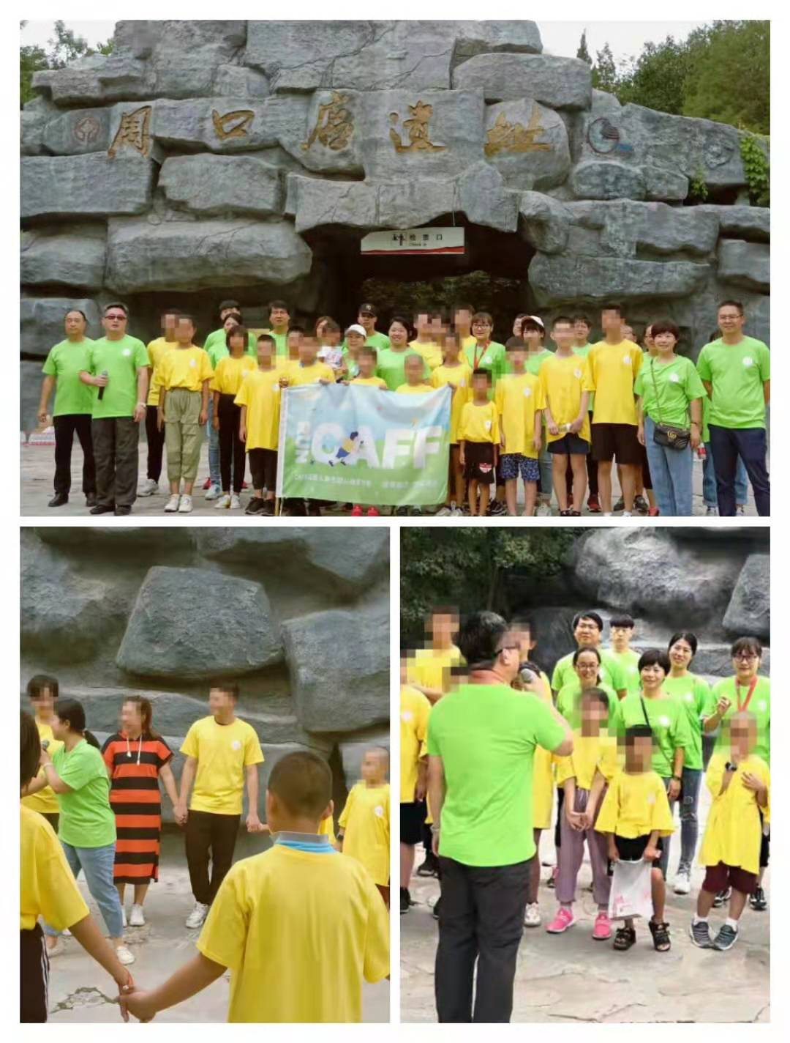
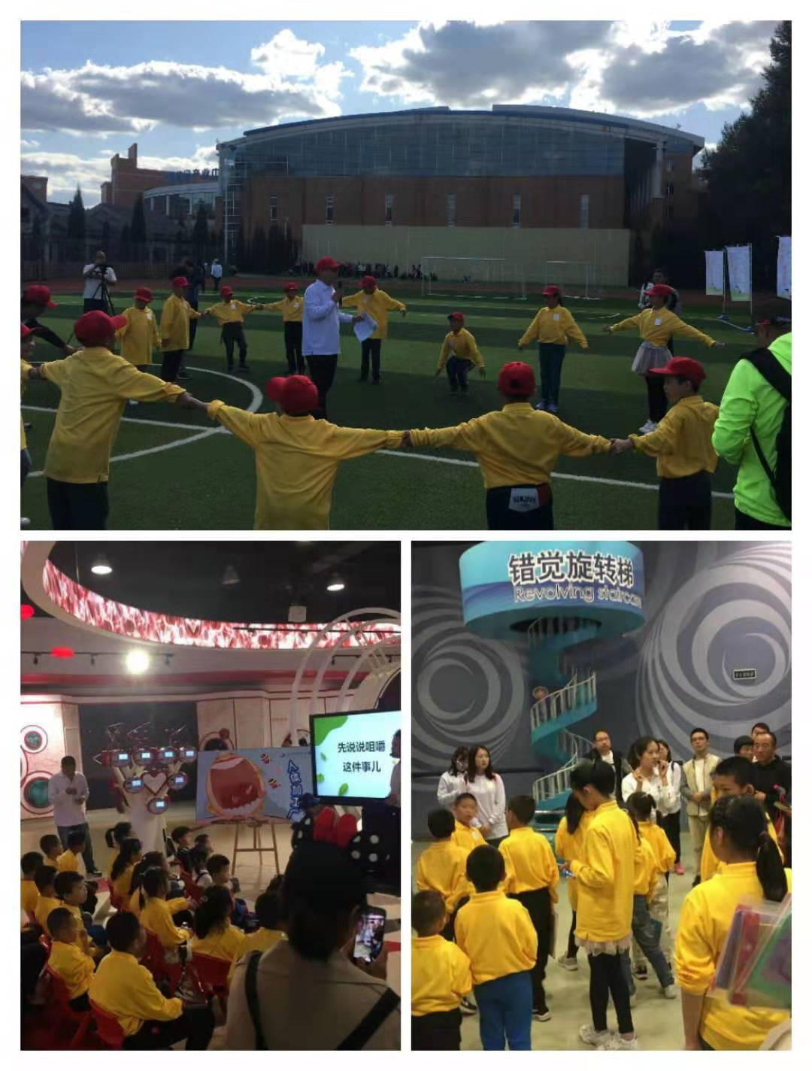
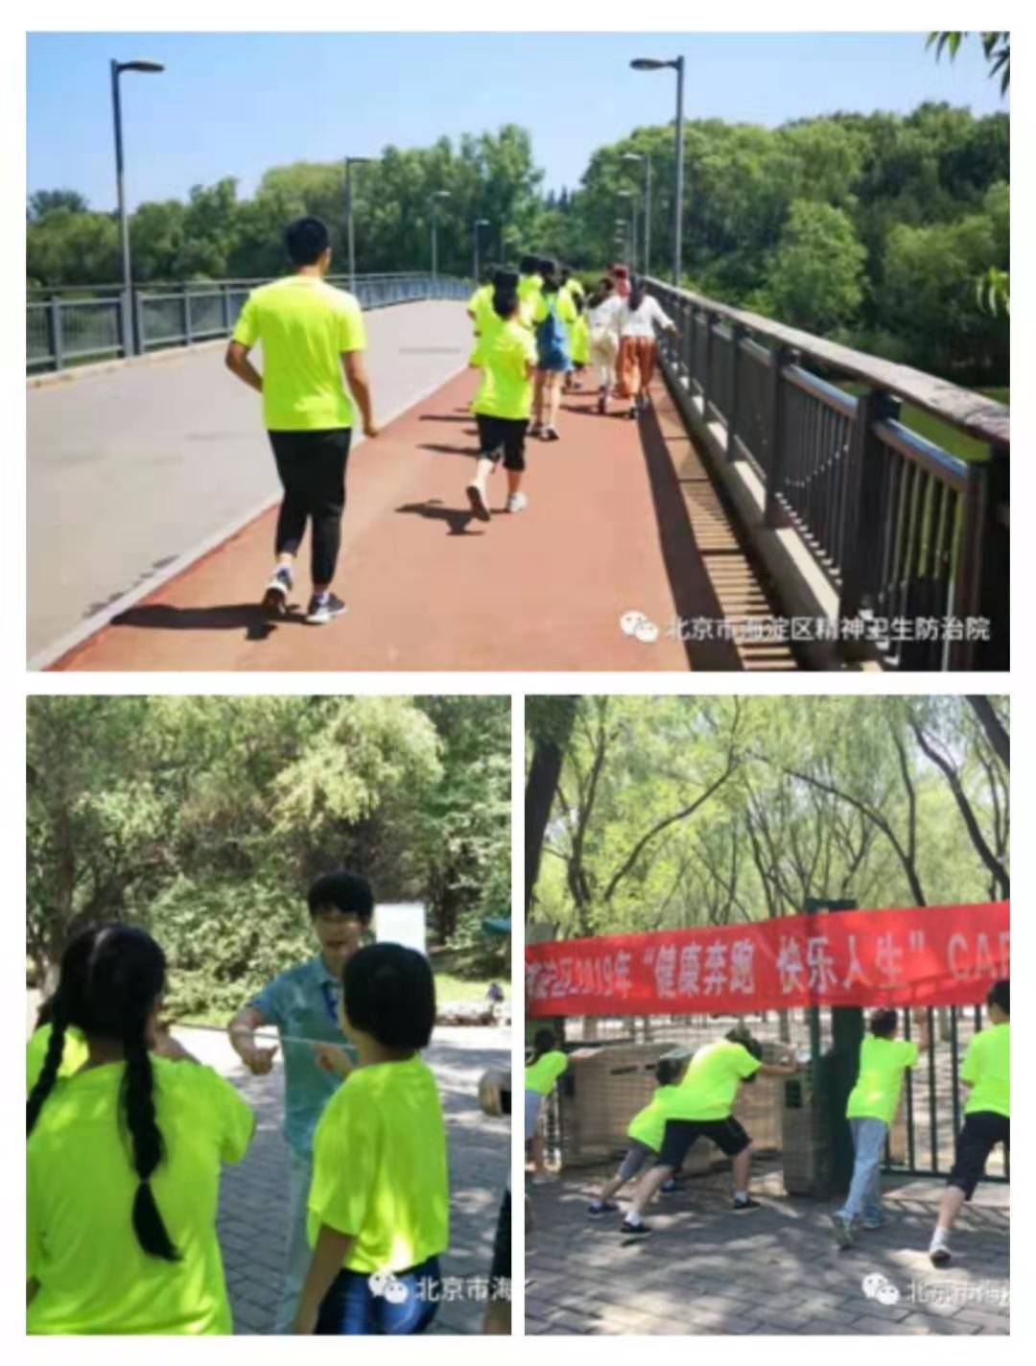
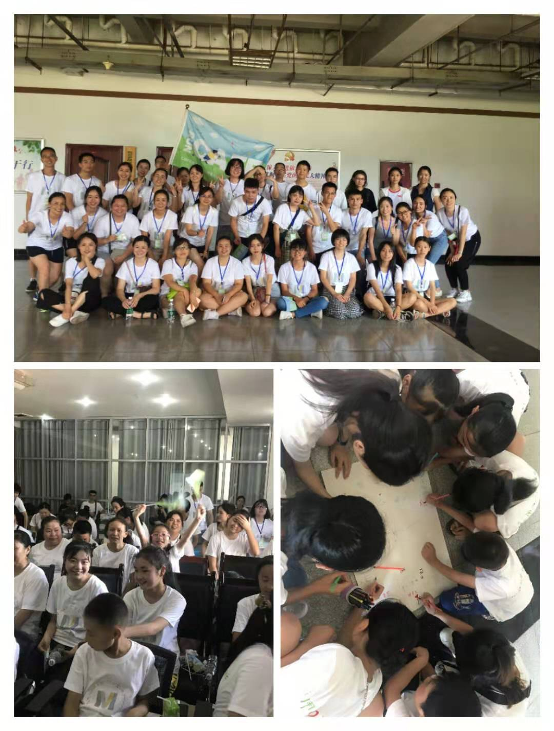
Run for Wellness, Live for Flourish
CAFF Summer Camps

Slide 9
Preliminary results- Quantitate data
Notes:
22 married 8

Slide 10






Preliminary results- Quantitate data
Among the 20 children and adolescents participating in the 2019 national CAFF camp:
7 had attenuated psychotic symptoms (assessed by SIPS).
4 were diagnosed as Depression/Bipolar Disorder and referred to child psychiatrists.
Notes:
22 married 8

Slide 11
Preliminary results- Qualitative data
Feeling loved
“You are like the guardian of our hearts. No matter what we do, you are very calm and care for us. Thank you!”
Boosting confidence
“I become more confident, more shinning, and think more about others and the group.”
Being connected and Having fun
“In this camp, I not only learned a lot of knowledge, but also experienced the warmth of our team. I am very happy and make some new friends. I learned how to get along with others, and also felt the feelings between people.”
Notes:
22 married 8

Slide 12
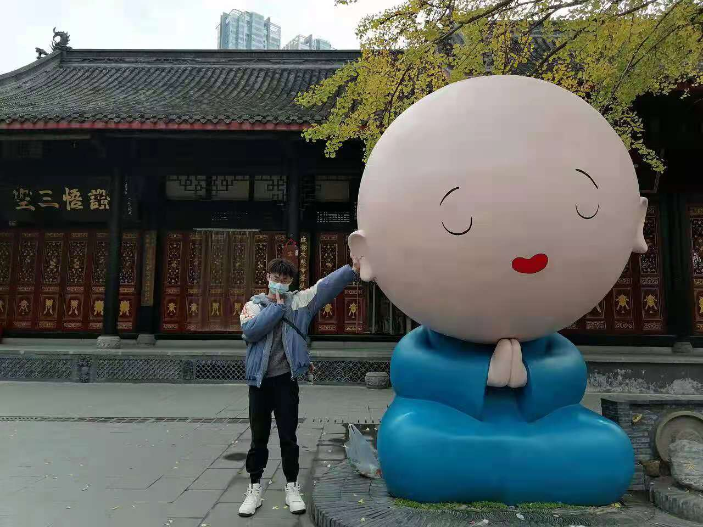
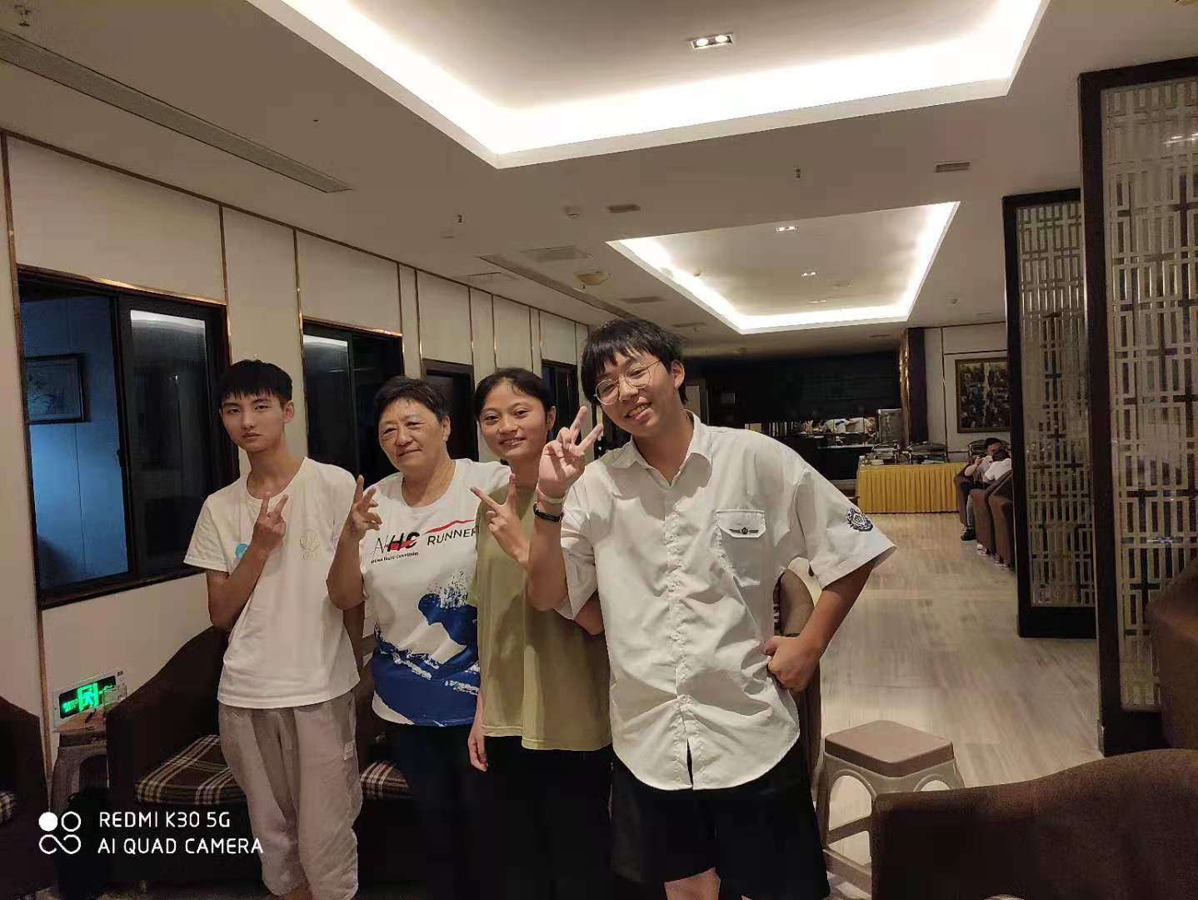
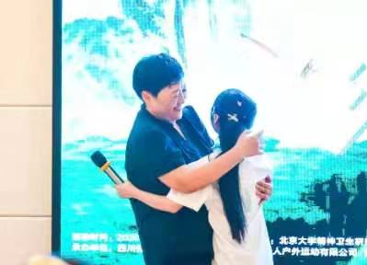
Future, deserve looking forward.
Notes:
22 married 8

Slide 13






Thanks to all team members!
Thanks to all COPMI for their trust and cooperation!
Thanks to all volunteers for their support and help!
Welcome to our WeChat official account

Slide 14
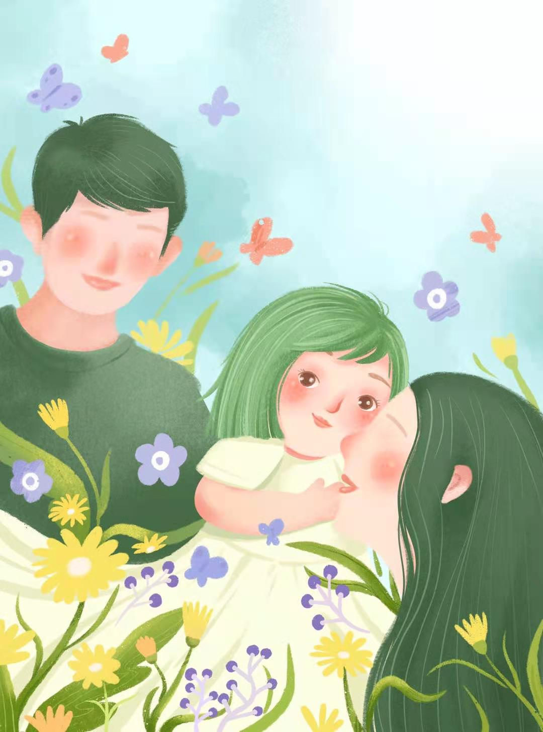
Accompany growth and wait for bloom!

